Slide 1
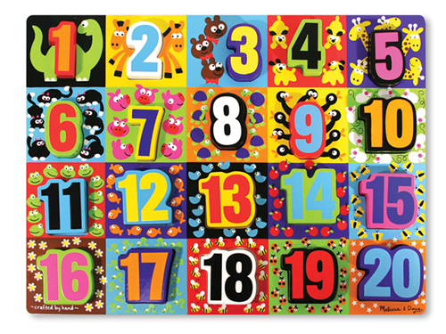
Module 5
Numbers 10-20 and
Counting to 100

Slide 2
Lesson Links
Click on the lesson you want to go to!
(You must be in Slide Show/Presentation Mode.)
Lesson 1 Lesson 8 Lesson 2 Lesson 9 Lesson 3 Lesson 10 Lesson 4 Lesson 11 Lesson 5 Lesson 12 Lesson 6 Lesson 13
Lesson 7 Lesson 14

Slide 3


Lesson 1
I can count and circle groups of 10.

Slide 4



Module 5, Lesson 1
Fluency
Finger Counting from Left to Right
Hover your fingers like you are playing the piano. Drop each finger as you count and leave it down. We won’t always start at 1, so listen carefully!
Count from 1 to 10.

Slide 5
Module 5, Lesson 1
Fluency
Finger Counting from Left to Right
Hover your fingers like you are playing the piano. Drop each finger as you count and leave it down. We won’t always start at 1, so listen carefully!
Count from 5 to 7.

Slide 6
Module 5, Lesson 1
Fluency
Finger Counting from Left to Right
Hover your fingers like you are playing the piano. Drop each finger as you count and leave it down. We won’t always start at 1, so listen carefully!
Count from 3 to 8.

Slide 7
Module 5, Lesson 1
Fluency
Finger Counting from Left to Right
Hover your fingers like you are playing the piano. Drop each finger as you count and leave it down. We won’t always start at 1, so listen carefully!
Count from 6 to 10.

Slide 8
Module 5, Lesson 1
Fluency
Finger Counting from Left to Right
Hover your fingers like you are playing the piano. Drop each finger as you count and leave it down. We won’t always start at 1, so listen carefully!
Count from 2 to 6.

Slide 9
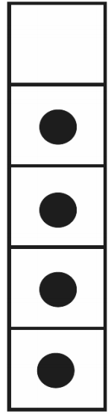


Module 5, Lesson 1
Fluency
5-Group Flashes: Partners to 5
How many dots do you see? How many more to make 5? Say the addition sentence.

Slide 10
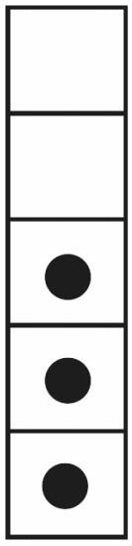
Module 5, Lesson 1
Fluency
5-Group Flashes: Partners to 5
How many dots do you see? How many more to make 5? Say the addition sentence.

Slide 11
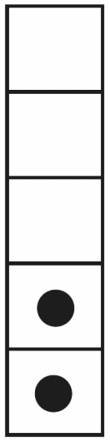
Module 5, Lesson 1
Fluency
5-Group Flashes: Partners to 5
How many dots do you see? How many more to make 5? Say the addition sentence.

Slide 12
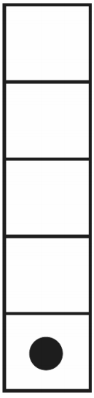
Module 5, Lesson 1
Fluency
5-Group Flashes: Partners to 5
How many dots do you see? How many more to make 5? Say the addition sentence.

Slide 13
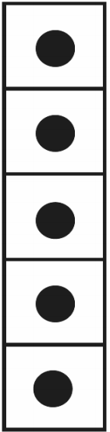
Module 5, Lesson 1
Fluency
5-Group Flashes: Partners to 5
How many dots do you see? How many more to make 5? Say the addition sentence.

Slide 14
Module 5, Lesson 1
Fluency
5-Group Flashes: Partners to 5
How many dots do you see? How many more to make 5? Say the addition sentence.

Slide 15
Module 5, Lesson 1
Fluency
5-Group Flashes: Partners to 5
How many dots do you see? How many more to make 5? Say the addition sentence.

Slide 16
Module 5, Lesson 1
Fluency
5-Group Flashes: Partners to 5
How many dots do you see? How many more to make 5? Say the addition sentence.

Slide 17
Module 5, Lesson 1
Fluency
5-Group Flashes: Partners to 5
How many dots do you see? How many more to make 5? Say the addition sentence.

Slide 18
Module 5, Lesson 1
Fluency
5-Group Flashes: Partners to 5
How many dots do you see? How many more to make 5? Say the addition sentence.

Slide 19
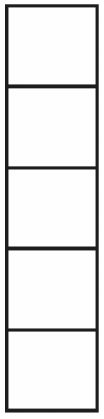
Module 5, Lesson 17
Fluency
5-Frame Flashes
How many dots do you see? How many more to make 5? Say the addition sentence.

Slide 20
Module 5, Lesson 17
Fluency
5-Frame Flashes
How many dots do you see? How many more to make 5? Say the addition sentence.

Slide 21
Module 5, Lesson 17
Fluency
5-Frame Flashes
How many dots do you see? How many more to make 5? Say the addition sentence.

Slide 22
Module 5, Lesson 17
Fluency
5-Frame Flashes
How many dots do you see? How many more to make 5? Say the addition sentence.

Slide 23
Module 5, Lesson 1
Fluency
5-Group Flashes: Partners to 5
How many dots do you see? How many more to make 5? Say the addition sentence.

Slide 24
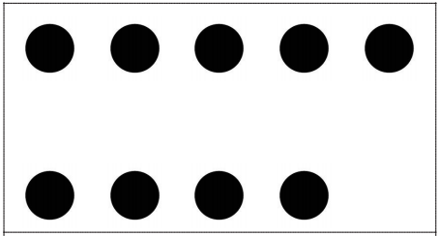

Module 5, Lesson 1
Fluency
5-Group Flashes: Partners to 10
How many dots do you see? How many more to make 10? Say the number sentence.

Slide 25
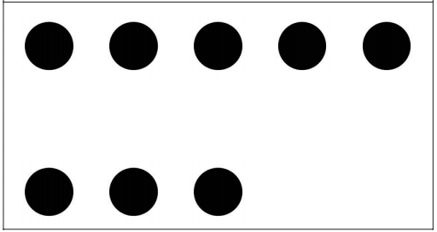
Module 5, Lesson 1
Fluency
5-Group Flashes: Partners to 10
How many dots do you see? How many more to make 10? Say the number sentence.

Slide 26
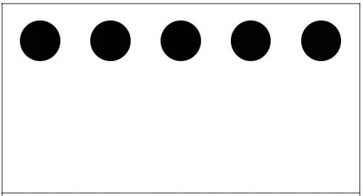
Module 5, Lesson 1
Fluency
5-Group Flashes: Partners to 10
How many dots do you see? How many more to make 10? Say the number sentence.

Slide 27
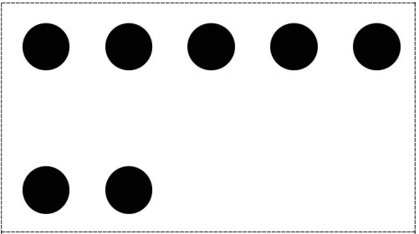
Module 5, Lesson 1
Fluency
5-Group Flashes: Partners to 10
How many dots do you see? How many more to make 10? Say the number sentence.

Slide 28
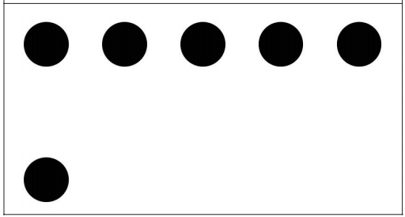
Module 5, Lesson 1
Fluency
5-Group Flashes: Partners to 10
How many dots do you see? How many more to make 10? Say the number sentence.

Slide 29

Module 5, Lesson 1
Fluency
5-Group Flashes: Partners to 10
How many dots do you see? How many more to make 10? Say the number sentence.

Slide 30
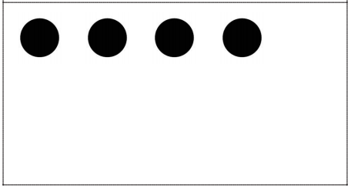
Module 5, Lesson 1
Fluency
5-Group Flashes: Partners to 10
How many dots do you see? How many more to make 10? Say the number sentence.

Slide 31
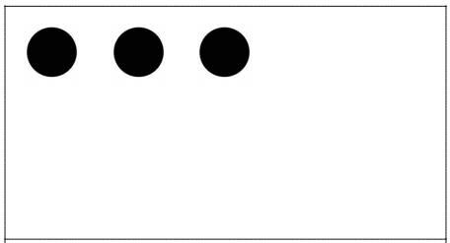
Module 5, Lesson 1
Fluency
5-Group Flashes: Partners to 10
How many dots do you see? How many more to make 10? Say the number sentence.

Slide 32
Module 5, Lesson 1
Fluency
5-Group Flashes: Partners to 10
How many dots do you see? How many more to make 10? Say the number sentence.

Slide 33
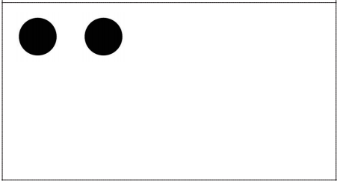
Module 5, Lesson 1
Fluency
5-Group Flashes: Partners to 10
How many dots do you see? How many more to make 10? Say the number sentence.

Slide 34
Module 5, Lesson 1
Fluency
5-Group Flashes: Partners to 10
How many dots do you see? How many more to make 10? Say the number sentence.

Slide 35
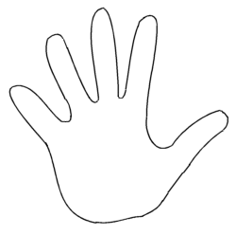

Application Problem
Module 5, Lesson 1
Marta loves to share her peanuts at recess. She
Counted 10 peanuts into the hands of her friend Joey. Draw a picture of the peanuts in Joey’s hands.

Slide 36

We will be learning about teen numbers, which are a group of 10, and some more.

Slide 37
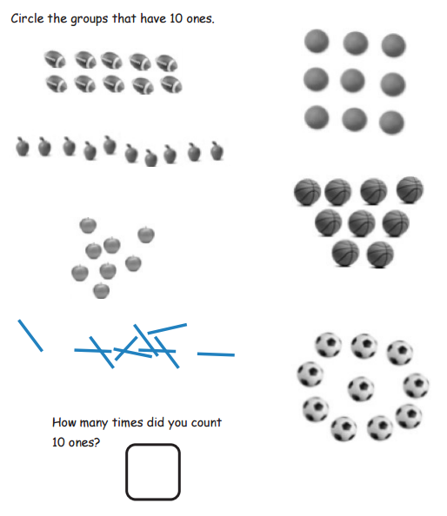

Slide 38

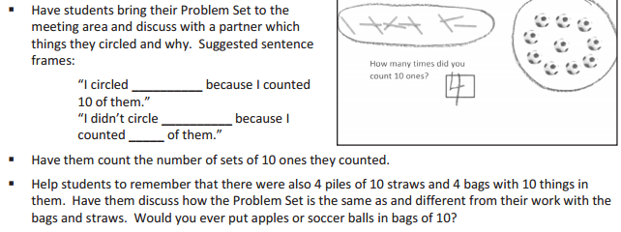


Debrief

Slide 39
Lesson 2
I can count 10 objects in a group of 10 to 20 objects. I can describe it as 10 ones and __ ones.

Slide 40

Module 5, Lesson 2
Fluency
How Many is One More?
How many dots? What’s one more?
“__ is one more than __.”

Slide 41
Module 5, Lesson 2
Fluency
How Many is One More?
How many dots? What’s one more?
“__ is one more than __.”

Slide 42
Module 5, Lesson 2
Fluency
How Many is One More?
How many dots? What’s one more?
“__ is one more than __.”

Slide 43
Module 5, Lesson 2
Fluency
How Many is One More?
How many dots? What’s one more?
“__ is one more than __.”

Slide 44
Module 5, Lesson 2
Fluency
How Many is One More?
How many dots? What’s one more?
“__ is one more than __.”

Slide 45
Module 5, Lesson 2
Fluency
How Many is One More?
How many dots? What’s one more?
“__ is one more than __.”

Slide 46
Module 5, Lesson 2
Fluency
How Many is One More?
How many dots? What’s one more?
“__ is one more than __.”

Slide 47
Module 5, Lesson 2
Fluency
How Many is One More?
How many dots? What’s one more?
“__ is one more than __.”

Slide 48
Module 5, Lesson 2
Fluency
How Many is One More?
How many dots? What’s one more?
“__ is one more than __.”

Slide 59
Module 5, Lesson 2
Fluency
How Many is One More?
How many dots? What’s one more?
“__ is one more than __.”

Slide 60
Module 5, Lesson 2
Fluency
How Many is One More?
How many dots? What’s one more?
“__ is one more than __.”

Slide 61
Module 5, Lesson 2
Fluency
How Many is One More?
How many dots? What’s one more?
“__ is one more than __.”

Slide 62


Module 5, Lesson 2
Fluency
Show One More on Fingers
Count the number of beads. Count one more on your fingers left to right (like playing a piano).

Slide 63

Module 5, Lesson 2
Fluency
Show One More on Fingers
Count the number of beads. Count one more on your fingers left to right (like playing a piano).

Slide 64

Module 5, Lesson 2
Fluency
Show One More on Fingers
Count the number of beads. Count one more on your fingers left to right (like playing a piano).

Slide 65
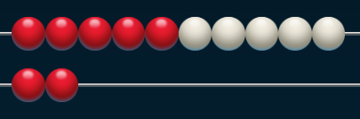
Module 5, Lesson 2
Fluency
Show One More on Fingers
Count the number of beads. Count one more on your fingers left to right (like playing a piano).

Slide 66
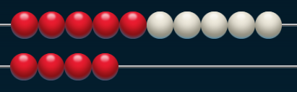
Module 5, Lesson 2
Fluency
Show One More on Fingers
Count the number of beads. Count one more on your fingers left to right (like playing a piano).

Slide 67
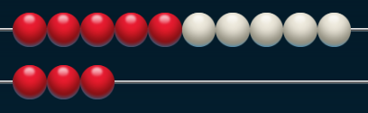
Module 5, Lesson 2
Fluency
Show One More on Fingers
Count the number of beads. Count one more on your fingers left to right (like playing a piano).

Slide 68
Module 5, Lesson 2
Fluency
Show One More on Fingers
Count the number of beads. Count one more on your fingers left to right (like playing a piano).

Slide 69
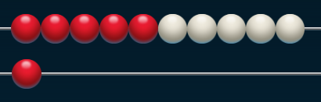
Module 5, Lesson 2
Fluency
Show One More on Fingers
Count the number of beads. Count one more on your fingers left to right (like playing a piano).

Slide 70

Module 5, Lesson 2
Fluency
Count Piles of Ten
See how many piles of 10 straws you can count!

Slide 71
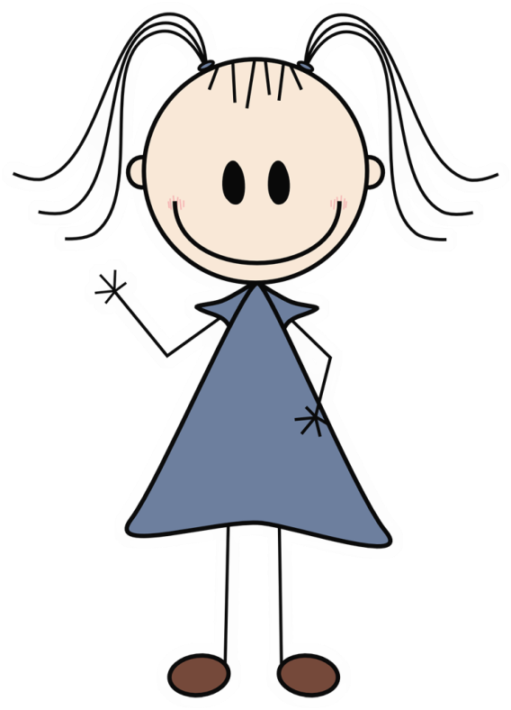
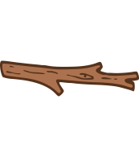
Application Problem
Module 5, Lesson 2
Lisa counted some sticks into one pile of 10. She
counted 5 other sticks into another pile. Draw a picture
to show Lisa’s piles of sticks.

Slide 72
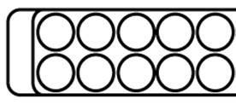
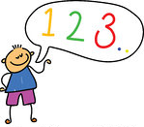
Module 5, Lesson 2
Count to see how many slots
are in your egg carton.

Slide 73
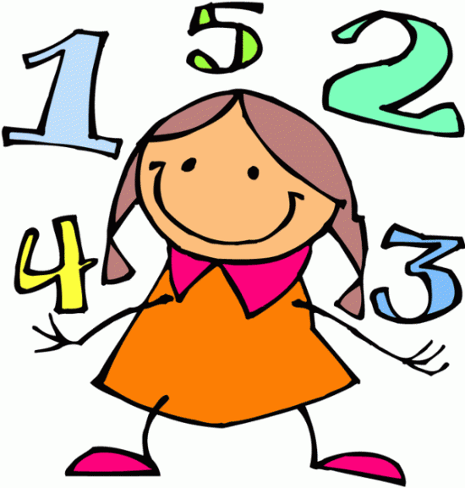
Module 5, Lesson 2
Count the things in your bags by first filling the egg carton. Then, put the extra things beside the carton.
“I have 10 ones and ________ ones.”

Slide 74
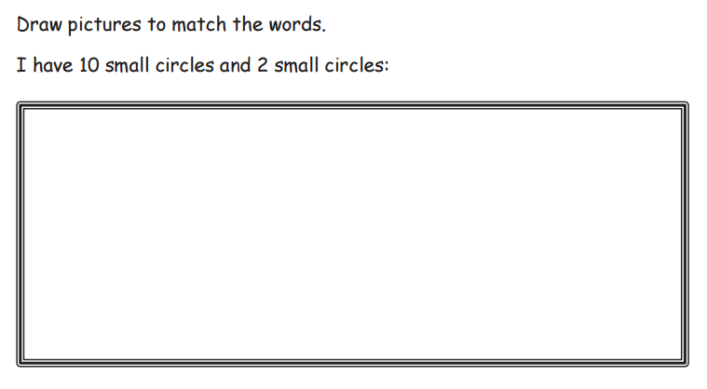

Slide 75
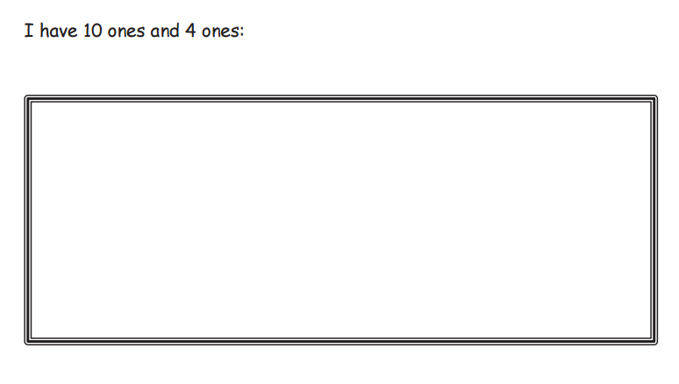

Slide 76
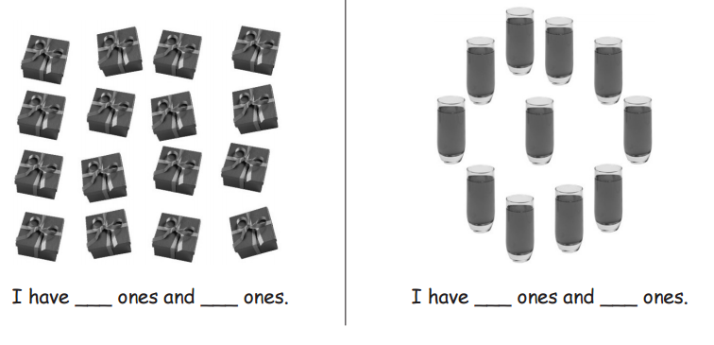

Slide 77
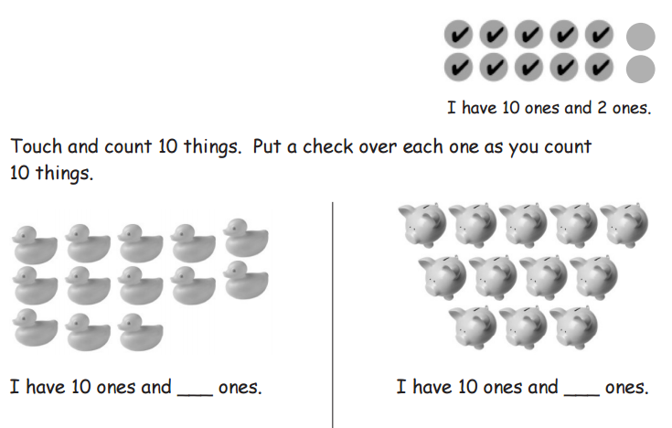

Slide 78
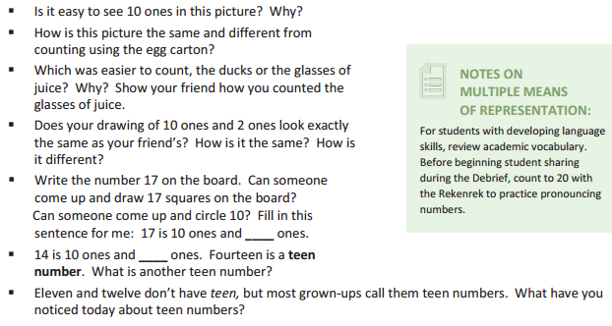
Debrief

Slide 79
Lesson 3
I can count and circle 10 objects in pictures of 10 to 20 objects. I can describe it as 10 ones and __ ones.

Slide 80
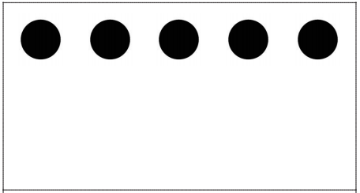

Module 5, Lesson 3
Fluency
Hide 1
Use your imagination to hide 1. How many are left?

Slide 81
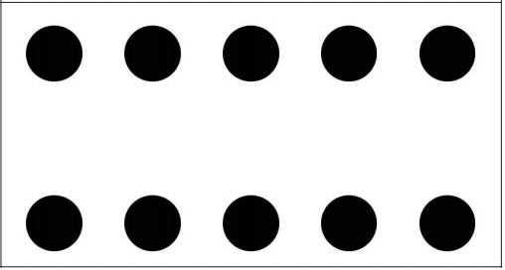
Module 5, Lesson 3
Fluency
Hide 1
Use your imagination to hide 1. How many are left?

Slide 82

Module 5, Lesson 3
Fluency
Hide 1
Use your imagination to hide 1. How many are left?

Slide 83
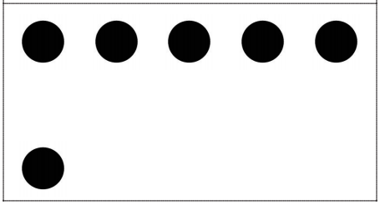
Module 5, Lesson 3
Fluency
Hide 1
Use your imagination to hide 1. How many are left?

Slide 84
Module 5, Lesson 3
Fluency
Hide 1
Use your imagination to hide 1. How many are left?

Slide 85
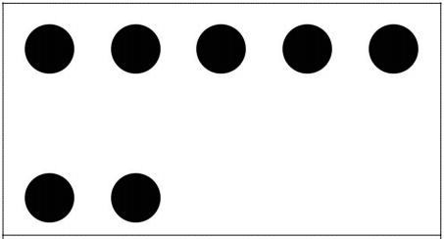
Module 5, Lesson 3
Fluency
Hide 1
Use your imagination to hide 1. How many are left?

Slide 86
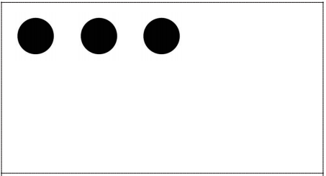
Module 5, Lesson 3
Fluency
Hide 1
Use your imagination to hide 1. How many are left?

Slide 87

Module 5, Lesson 3
Fluency
Hide 1
Use your imagination to hide 1. How many are left?

Slide 88

Module 5, Lesson 3
Fluency
Hide 1
Use your imagination to hide 1. How many are left?

Slide 89
Module 5, Lesson 3
Fluency
Hide 1
Use your imagination to hide 1. How many are left?

Slide 90

Module 5, Lesson 3
Fluency
How Many Do You See?
Look carefully! I will only show you for a second!
Wait for the signal. How many dots did you see?
Who can explain how they see this number?

Slide 91
Module 5, Lesson 3
Fluency
How Many Do You See?
Look carefully! I will only show you for a second!
Wait for the signal. How many dots did you see?
Who can explain how they see this number?

Slide 92
Module 5, Lesson 3
Fluency
How Many Do You See?
Look carefully! I will only show you for a second!
Wait for the signal. How many dots did you see?
Who can explain how they see this number?

Slide 93
Module 5, Lesson 3
Fluency
How Many Do You See?
Look carefully! I will only show you for a second!
Wait for the signal. How many dots did you see?
Who can explain how they see this number?

Slide 94
Module 5, Lesson 3
Fluency
How Many Do You See?
Look carefully! I will only show you for a second!
Wait for the signal. How many dots did you see?
Who can explain how they see this number?

Slide 95
Module 5, Lesson 3
Fluency
How Many Do You See?
Look carefully! I will only show you for a second!
Wait for the signal. How many dots did you see?
Who can explain how they see this number?

Slide 96
Module 5, Lesson 3
Fluency
How Many Do You See?
Look carefully! I will only show you for a second!
Wait for the signal. How many dots did you see?
Who can explain how they see this number?

Slide 97

Module 5, Lesson 3
Fluency
Grouping 10 Objects
Place the items from your bag on your work mat. Count out 10 ones, and move them together into a bunch. By counting, prove to your partner that there are 10 things in your bunch. Push all your things back together. Mix them up. Count out 10 ones again, and move them together into a bunch…

Slide 98

Application Problem
Module 5, Lesson 3
Each gingerbread man got 10 sprinkles for buttons
and 2 sprinkles to show the eyes. Draw to show the
12 sprinkles as 10 buttons and 2 eyes.

Slide 99

Module 5, Lesson 3
Use your finger to circle the 10 ones from your seat.
Can you see the 3 ones without counting?
Can you count 10 ones in my picture?
Who can come to the board and show us how?
Let’s count all the circles!

Slide 100
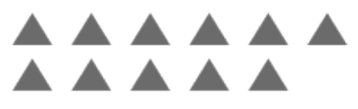
Module 5, Lesson 3
Now, use your pencil to find and circle 10 ones.
Trade papers with your partner, and count to be sure
he circled exactly 10 ones.
How many extra ones did you have after you
counted the 10 triangles?
Find 10 triangles inside this group of triangles.
Circle them with your finger!

Slide 101

Module 5, Lesson 3
Now, use your pencil to find and circle 10 ones.
Trade papers with your partner, and count to be sure
he circled exactly 10 ones.
Find 10 circles inside this group of circles.
Circle them with your finger!
How many extra ones did you have after you
counted the 10 circles?

Slide 102

Module 5, Lesson 3
Now, use your pencil to find and circle 10 ones.
Trade papers with your partner, and count to be sure
he circled exactly 10 ones.
How many extra ones did you have after you
counted the 10 squares?
Find 10 squares inside this group of squares.
Circle them with your finger!

Slide 103

Module 5, Lesson 3
Now, use your pencil to find and circle 10 ones.
Trade papers with your partner, and count to be sure
he circled exactly 10 ones.
How many extra ones did you have after you
counted the 10 flowers?
Find 10 flowers inside this group of flowers.
Circle them with your finger!

Slide 104

Module 5, Lesson 3
Now, use your pencil to find and circle 10 ones.
Trade papers with your partner, and count to be sure
he circled exactly 10 ones.
How many extra ones did you have after you
counted the 10 hearts?
Find 10 hearts inside this group of hearts.
Circle them with your finger!

Slide 105

Module 5, Lesson 3
Now, use your pencil to find and circle 10 ones.
Trade papers with your partner, and count to be sure
he circled exactly 10 ones.
How many extra ones did you have after you
counted the 10 X’s?
Find 10 X’s inside this group of X’s.
Circle them with your finger!

Slide 106
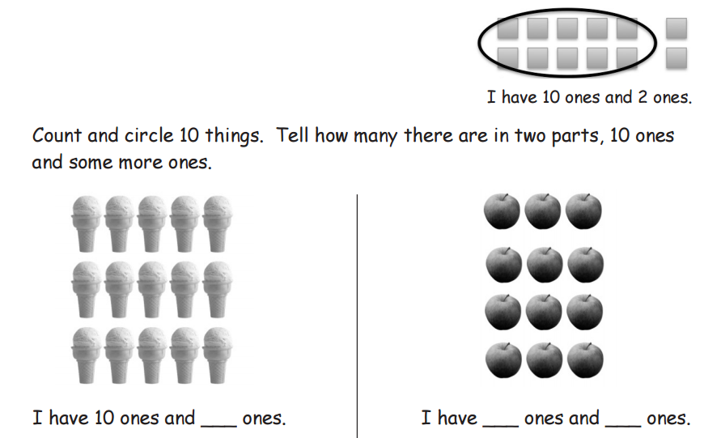

Slide 107
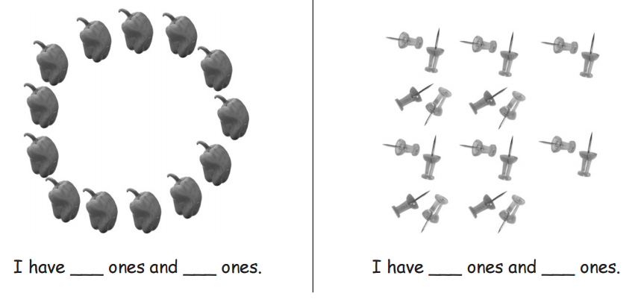

Slide 108
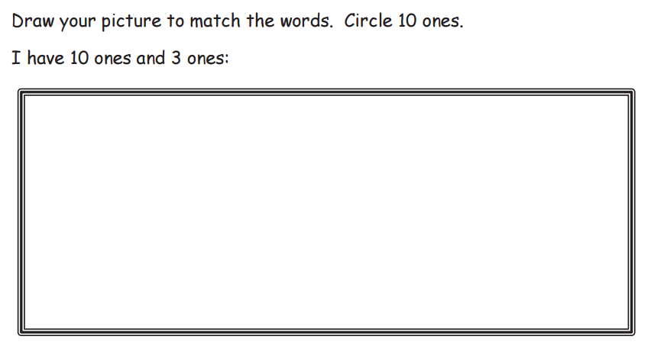

Slide 109
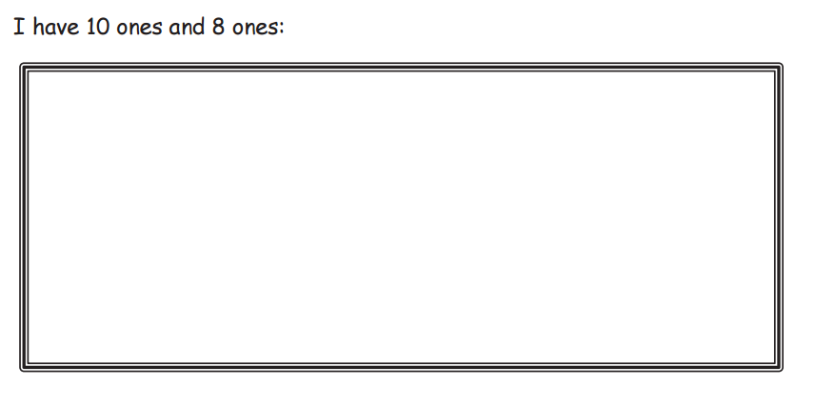

Slide 110
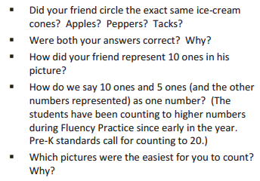
Debrief

Slide 111
Lesson 4
I can count straws the Say Ten way to 19. I can make a pile for each ten.

Slide 112
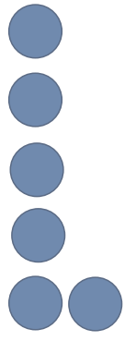

Module 5, Lesson 4
Fluency
Dot Cards of Six
How many dots do you see? How did you see them in two parts?

Slide 113
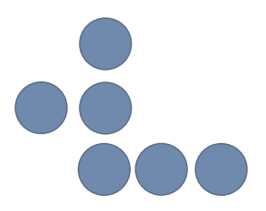
Module 5, Lesson 4
Fluency
Dot Cards of Six
How many dots do you see? How did you see them in two parts?

Slide 114
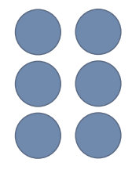
Module 5, Lesson 4
Fluency
Dot Cards of Six
How many dots do you see? How did you see them in two parts?

Slide 115
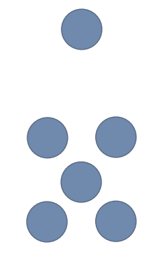
Module 5, Lesson 4
Fluency
Dot Cards of Six
How many dots do you see? How did you see them in two parts?

Slide 116
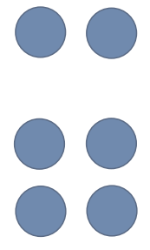
Module 5, Lesson 4
Fluency
Dot Cards of Six
How many dots do you see? How did you see them in two parts?

Slide 117

Module 5, Lesson 4
Fluency
Dot Cards of Six
How many dots do you see? How did you see them in two parts?

Slide 118
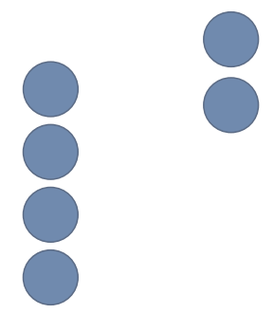
Module 5, Lesson 4
Fluency
Dot Cards of Six
How many dots do you see? How did you see them in two parts?

Slide 119
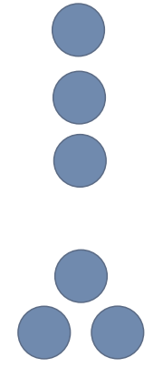
Module 5, Lesson 4
Fluency
Dot Cards of Six
How many dots do you see? How did you see them in two parts?

Slide 120

Module 5, Lesson 4
Fluency
Number Pairs of Six
Say the larger part. Say the smaller part. What is the total number of dots? Show the number bond on your personal white board.

Slide 121
Module 5, Lesson 4
Fluency
Number Pairs of Six
Say the larger part. Say the smaller part. What is the total number of dots? Show the number bond on your personal white board.

Slide 122
Module 5, Lesson 4
Fluency
Number Pairs of Six
Say the top part. Say the bottom part. What is the total number of dots? Show the number bond on your personal white board.

Slide 123
Module 5, Lesson 4
Fluency
Number Pairs of Six
Say the larger part. Say the smaller part. What is the total number of dots? Show the number bond on your personal white board.

Slide 124


Module 5, Lesson 4
Fluency
Circle Ten Objects

Slide 125


Application Problem
Module 5, Lesson 4
At recess, 17 students were playing. 10 students played handball while 7 students played tetherball. Draw to show the 17 students as 10 students playing handball and 7 students playing tetherball.

Slide 126


Module 5, Lesson 4
How many cubes do you see?

Slide 127
Module 5, Lesson 4
Now, how many do you see?

Slide 128
Module 5, Lesson 4
I’m going to teach you to count the Say Ten way today!
How many linking cubes is this?

Slide 129


Module 5, Lesson 4
Every time we add another cube, we will say, “Ten” and the number of cubes you see on the extra hand.

Slide 130
Module 5, Lesson 4
Now, let’s practice the Say Ten way using straws.
Partner A, count 10 straws into a pile.
Partner B, place one straw next to the pile.
We’ll say, “Ten 1.”
Put your straws back in a pile, switch roles,
and do it again!

Slide 131


Slide 132


Slide 133

Debrief

Slide 134
Lesson 5
I can count straws the Say Ten way to 20. I can make a pile for each ten.

Slide 135

Module 5, Lesson 5
Fluency
Dot Cards of Seven
How many dots do you see? How did you see them in two parts?

Slide 136

Module 5, Lesson 5
Fluency
Dot Cards of Seven
How many dots do you see? How did you see them in two parts?

Slide 137

Module 5, Lesson 5
Fluency
Dot Cards of Seven
How many dots do you see? How did you see them in two parts?

Slide 138

Module 5, Lesson 5
Fluency
Dot Cards of Seven
How many dots do you see? How did you see them in two parts?

Slide 139

Module 5, Lesson 5
Fluency
Dot Cards of Seven
How many dots do you see? How did you see them in two parts?

Slide 140

Module 5, Lesson 5
Fluency
Dot Cards of Seven
How many dots do you see? How did you see them in two parts?

Slide 141

Module 5, Lesson 5
Fluency
Dot Cards of Seven
How many dots do you see? How did you see them in two parts?

Slide 142

Module 5, Lesson 5
Fluency
Dot Cards of Seven
How many dots do you see? How did you see them in two parts?

Slide 143

Module 5, Lesson 5
Fluency
Dot Cards of Seven
How many dots do you see? How did you see them in two parts?

Slide 144
Module 5, Lesson 5
Fluency
Number Pairs of Seven
Say the larger part. Say the smaller part. What is the total number of dots? Show the number bond on your personal white board.

Slide 145
Module 5, Lesson 5
Fluency
Number Pairs of Seven
Say the larger part. Say the smaller part. What is the total number of dots? Show the number bond on your personal white board.

Slide 146
Module 5, Lesson 5
Fluency
Number Pairs of Seven
Say the larger part. Say the smaller part. What is the total number of dots? Show the number bond on your personal white board.

Slide 147
Module 5, Lesson 5
Fluency
Number Pairs of Seven
Say the larger part. Say the smaller part. What is the total number of dots? Show the number bond on your personal white board.

Slide 148


Module 5, Lesson 5
Fluency
Circling 10 Ones

Slide 149

Application Problem
Module 5, Lesson 5
Pat covered 16 holes when playing the flute. She covered
10 holes with her fingers on the first note she played. She covered 6 holes on the next note she played. Draw the 10 holes. Draw the 6 holes. Use your drawing to count all the holes the Say Ten way.

Slide 150
Module 5, Lesson 5
I’m going to show you some numbers. Tell me
the number, then tell me the Say Ten way.

Slide 151
Module 5, Lesson 5
I’m going to show you some numbers. Tell me
the number, then tell me the Say Ten way.

Slide 152
Module 5, Lesson 5
I’m going to show you some numbers. Tell me
the number, then tell me the Say Ten way.

Slide 153
Module 5, Lesson 5
I’m going to show you some numbers. Tell me
the number, then tell me the Say Ten way.

Slide 154
Module 5, Lesson 5
I’m going to show you some numbers. Tell me
the number, then tell me the Say Ten way.

Slide 155
Module 5, Lesson 5
I’m going to show you some numbers. Tell me
the number, then tell me the Say Ten way.

Slide 156
Module 5, Lesson 5
I’m going to show you some numbers. Tell me
the number, then tell me the Say Ten way.

Slide 157
Module 5, Lesson 5
I’m going to show you some numbers. Tell me
the number, then tell me the Say Ten way.

Slide 158
Module 5, Lesson 5
I’m going to show you some numbers. Tell me
the number, then tell me the Say Ten way.

Slide 159
Module 5, Lesson 5
What comes after 19?

Slide 160
Module 5, Lesson 5
Now, let’s practice the Say Ten way using straws.
Partner A, count 10 straws into a pile.
Partner B, place one straw next to the pile.
We’ll say, “Ten 1.”
Put your straws back in a pile, switch roles,
and do it again!

Slide 161


Slide 162

Debrief

Slide 163
Lesson 6
I can use objects to show numbers 10 to 20. I can use place value or Hide Zero cards to show numbers 10 to 20.

Slide 164

Module 5, Lesson 6
Fluency
How Many More to Make 10?
How many dots? How many more to make 10?
“__ needs __ more to make 10.”

Slide 165
Module 5, Lesson 6
Fluency
How Many More to Make 10?
How many dots? How many more to make 10?
“__ needs __ more to make 10.”

Slide 166
Module 5, Lesson 6
Fluency
How Many More to Make 10?
How many dots? How many more to make 10?
“__ needs __ more to make 10.”

Slide 167
Module 5, Lesson 6
Fluency
How Many More to Make 10?
How many dots? How many more to make 10?
“__ needs __ more to make 10.”

Slide 168
Module 5, Lesson 6
Fluency
How Many More to Make 10?
How many dots? How many more to make 10?
“__ needs __ more to make 10.”

Slide 169
Module 5, Lesson 6
Fluency
How Many More to Make 10?
How many dots? How many more to make 10?
“__ needs __ more to make 10.”

Slide 170
Module 5, Lesson 6
Fluency
How Many More to Make 10?
How many dots? How many more to make 10?
“__ needs __ more to make 10.”

Slide 171
Module 5, Lesson 6
Fluency
How Many More to Make 10?
How many dots? How many more to make 10?
“__ needs __ more to make 10.”

Slide 172
Module 5, Lesson 6
Fluency
How Many More to Make 10?
How many dots? How many more to make 10?
“__ needs __ more to make 10.”

Slide 173
Module 5, Lesson 6
Fluency
How Many More to Make 10?
How many dots? How many more to make 10?
“__ needs __ more to make 10.”

Slide 174
Module 5, Lesson 6
Fluency
How Many More to Make 10?
How many dots? How many more to make 10?
“__ needs __ more to make 10.”

Slide 175

Module 5, Lesson 6
Fluency
Dot Cards of Eight
How many dots do you see? How did you see them in two parts?

Slide 176

Module 5, Lesson 6
Fluency
Dot Cards of Eight
How many dots do you see? How did you see them in two parts?

Slide 177

Module 5, Lesson 6
Fluency
Dot Cards of Eight
How many dots do you see? How did you see them in two parts?

Slide 178

Module 5, Lesson 6
Fluency
Dot Cards of Eight
How many dots do you see? How did you see them in two parts?

Slide 179

Module 5, Lesson 6
Fluency
Dot Cards of Eight
How many dots do you see? How did you see them in two parts?

Slide 180

Module 5, Lesson 6
Fluency
Dot Cards of Eight
How many dots do you see? How did you see them in two parts?

Slide 181

Module 5, Lesson 6
Fluency
Dot Cards of Eight
How many dots do you see? How did you see them in two parts?

Slide 182

Module 5, Lesson 6
Fluency
Dot Cards of Eight
How many dots do you see? How did you see them in two parts?

Slide 183

Module 5, Lesson 6
Fluency
Dot Cards of Eight
How many dots do you see? How did you see them in two parts?

Slide 184

Module 5, Lesson 6
Fluency
Counting Straws the Say Ten Way
Say the number the Say Ten Way. Count out that many straws with your partner.

Slide 185
Module 5, Lesson 6
Fluency
Counting Straws the Say Ten Way
Say the number the Say Ten Way. Count out that many straws with your partner.

Slide 186
Module 5, Lesson 6
Fluency
Counting Straws the Say Ten Way
Say the number the Say Ten Way. Count out that many straws with your partner.

Slide 187
Module 5, Lesson 6
Fluency
Counting Straws the Say Ten Way
Say the number the Say Ten Way. Count out that many straws with your partner.

Slide 188
Module 5, Lesson 6
Fluency
Counting Straws the Say Ten Way
Say the number the Say Ten Way. Count out that many straws with your partner.

Slide 189
Module 5, Lesson 6
Fluency
Counting Straws the Say Ten Way
Say the number the Say Ten Way. Count out that many straws with your partner.

Slide 190

Application Problem
Module 5, Lesson 6
There are 18 students: 10 girls and 8 boys. Show the
18 students as 10 girls and 8 boys.

Slide 191




Module 5, Lesson 6
Use your linking cubes to show the girls in one color and the boys in another color from the Application Problem.
Hold up the stick
that represents the
girls. How many
girls?
Hold up the stick
that represents the
boys. How many
boys?

Slide 192

Module 5, Lesson 6
Show the girls again.
1
0
Here is the number 10.

Slide 193

Module 5, Lesson 6
Show the boys again.
8
Here is the number 8.

Slide 194

Module 5, Lesson 6
Put your girls together with the boys.
Count the Say Ten way to see how many students you have.

Slide 195

Module 5, Lesson 6
How do we say the number of students the Say 10 way?
Watch this magic!
1
0
8

Slide 196

Module 5, Lesson 6
I’m going to give you a bag of these Hide Zero cards!
Partner A, pull out all the cards and put them in order from 1 to 10.
Partner B, show me ten 8 with your cards. Be sure to hide the 0!
1
0
8
Math

Slide 197

Module 5, Lesson 6
Partner A, use the cubes for this first turn.
Partner B, use the cards and write the number.
Show me ten 5!
1
0
5

Slide 198

Module 5, Lesson 6
Partner A, use the cards and write the number for this turn.
Partner B, use the cubes.
Show me ten 3!
1
0
3
I
Math

Slide 199

Module 5, Lesson 6
Partner A, use the cubes for this turn.
Partner B, use the cards and write the number.
Show me ten 9!
1
0
9

Slide 200

Module 5, Lesson 6
Partner A, use the cards and write the number for this turn.
Partner B, use the cubes.
Show me ten 1!
1
0
1

Slide 201


Module 5, Lesson 6
Now, use the dot side of the Hide Zero cards instead of cubes.
Partner A, pull out all the cards and put them in order from 10 to 1.
Partner B, match them with the numbers.

Slide 202

Module 5, Lesson 6
Partner A, use the dots for this first turn.
Partner B, use the cards and write the number.
Show me ten 4!
1
0
4

Slide 203

Module 5, Lesson 6
Partner A, use the cards and write the number for this turn.
Partner B, use the dots.
Show me ten 2!
1
0
2

Slide 204

Module 5, Lesson 6
Partner A, use the dots for this first turn.
Partner B, use the cards and write the number.
Show me ten 7!
1
0
7

Slide 205

Module 5, Lesson 6
Partner A, use the cards and write the number for this turn.
Partner B, use the dots.
Show me ten 6!
1
0
6

Slide 206


Slide 207


Slide 208

Debrief

Slide 209
Lesson 7
I can model and write numbers 10 to 20 as number bonds.

Slide 210
Module 5, Lesson 7
Fluency
Dot Cards of Eight
How many dots do you see? How did you see them in two parts?

Slide 211
Module 5, Lesson 7
Fluency
Dot Cards of Eight
How many dots do you see? How did you see them in two parts?

Slide 212
Module 5, Lesson 7
Fluency
Dot Cards of Eight
How many dots do you see? How did you see them in two parts?

Slide 213
Module 5, Lesson 7
Fluency
Dot Cards of Eight
How many dots do you see? How did you see them in two parts?

Slide 214
Module 5, Lesson 7
Fluency
Dot Cards of Eight
How many dots do you see? How did you see them in two parts?

Slide 215
Module 5, Lesson 7
Fluency
Dot Cards of Eight
How many dots do you see? How did you see them in two parts?

Slide 216
Module 5, Lesson 7
Fluency
Dot Cards of Eight
How many dots do you see? How did you see them in two parts?

Slide 217
Module 5, Lesson 7
Fluency
Dot Cards of Eight
How many dots do you see? How did you see them in two parts?

Slide 218
Module 5, Lesson 7
Fluency
Dot Cards of Eight
How many dots do you see? How did you see them in two parts?

Slide 219
Module 5, Lesson 7
Fluency
Counting
Partners hover their hands as if playing the piano. The partner on the teacher’s right begins by “playing” the pinky of the left hand and continuing from left to right. Once a finger is counted, it remains down. Keep counting on your partner’s hand first the Say Ten Way and then again the regular way. Count down from 20 to 0 if you finish early.

Slide 220

Module 5, Lesson 7
Fluency
Decompose Teen Numbers
Say the number the regular way.
1 0
2

Slide 221
Module 5, Lesson 7
Fluency
Decompose Teen Numbers
Say 12 the Say Ten Way.
1 0
2

Slide 222
Module 5, Lesson 7
Fluency
Decompose Teen Numbers
Say the number the regular way.
1 0
3

Slide 223
Module 5, Lesson 7
Fluency
Decompose Teen Numbers
Say 13 the Say Ten Way.
1 0
3

Slide 224
Module 5, Lesson 7
Fluency
Decompose Teen Numbers
Say the number the regular way.
1 0
4

Slide 225
Module 5, Lesson 7
Fluency
Decompose Teen Numbers
Say 14 the Say Ten Way.
1 0
4

Slide 226
Module 5, Lesson 7
Fluency
Decompose Teen Numbers
Say the number the regular way.
1 0
9

Slide 227
Module 5, Lesson 7
Fluency
Decompose Teen Numbers
Say 19 the Say Ten Way.
1 0
9

Slide 228
Module 5, Lesson 7
Fluency
Decompose Teen Numbers
Say the number the regular way.
1 0
1

Slide 229
Module 5, Lesson 7
Fluency
Decompose Teen Numbers
Say 11 the Say Ten Way.
1 0
1

Slide 230
Module 5, Lesson 7
Fluency
Decompose Teen Numbers
Say the number the regular way.
1 0
0

Slide 231
Module 5, Lesson 7
Fluency
Decompose Teen Numbers
Say 10 the Say Ten Way.
1 0
0

Slide 232
Module 5, Lesson 7
Fluency
Decompose Teen Numbers
Say the number the regular way.
1 0
5

Slide 233
Module 5, Lesson 7
Fluency
Decompose Teen Numbers
Say 15 the Say Ten Way.
1 0
5

Slide 234
Module 5, Lesson 7
Fluency
Decompose Teen Numbers
Say the number the regular way.
1 0
7

Slide 235
Module 5, Lesson 7
Fluency
Decompose Teen Numbers
Say 17 the Say Ten Way.
1 0
7

Slide 236
Module 5, Lesson 7
Fluency
Decompose Teen Numbers
Say the number the regular way.
1 0
6

Slide 237
Module 5, Lesson 7
Fluency
Decompose Teen Numbers
Say 16 the Say Ten Way.
1 0
6

Slide 238
Module 5, Lesson 7
Fluency
Decompose Teen Numbers
Say the number the regular way.
1 0
8

Slide 239
Module 5, Lesson 7
Fluency
Decompose Teen Numbers
Say 18 the Say Ten Way.
1 0
8

Slide 240

Application Problem
Module 5, Lesson 7
Gregory drew 10 smiley faces and 5 smiley faces. He put
them together and had 15 smiley faces. Draw the 15 smiley
faces as 10 smiley faces and 5 smiley faces. Then draw 15 with Hide Zero cards when the zero is hiding and when the zero is not hiding.

Slide 241

Module 5, Lesson 7
Here’s Gregory’s number with my Hide Zero cards.
1
0
5

Slide 242




Module 5, Lesson 7
Show Gregory’s number with your counters in the “total place”
of your number bond. Make 10 ones a different color from
the other ones.
Let’s finish the number bond by filling in the “parts”
with our Hide Zero cards!

Slide 243



Module 5, Lesson 7
Let’s switch it!

Slide 244

Module 5, Lesson 7
Now, let’s fill in the number bond by
writing the numbers ourselves!

Slide 245


Module 5, Lesson 7
Let’s make another number bond
with our counters!

Slide 246

Module 5, Lesson 7
Now, you write in the numbers!

Slide 247


Module 5, Lesson 7
Let’s make another number bond
with our counters!

Slide 248

Module 5, Lesson 7
Now, you write in the numbers!

Slide 249


Module 5, Lesson 7
Can you draw a number bond?

Slide 250


Slide 251


Slide 252


Slide 253


Slide 254

Debrief

Slide 255
Lesson 8
I can model teen numbers with different materials.

Slide 256
Module 5, Lesson 8
Fluency
Number Bonds of Eight
Say the larger part. Say the smaller part. What is the total number of dots? Show the number bond on your personal white board.

Slide 257
Module 5, Lesson 8
Fluency
Number Bonds of Eight
Say the larger part. Say the smaller part. What is the total number of dots? Show the number bond on your personal white board.

Slide 258
Module 5, Lesson 8
Fluency
Number Bonds of Eight
Say the top part. Say the bottom part. What is the total number of dots? Show the number bond on your personal white board.

Slide 259
Module 5, Lesson 8
Fluency
Number Bonds of Eight
Say the larger part. Say the smaller part. What is the total number of dots? Show the number bond on your personal white board.

Slide 260
Module 5, Lesson 8
Fluency
Number Bonds of Eight
Say the larger part. Say the smaller part. What is the total number of dots? Show the number bond on your personal white board.

Slide 261
Module 5, Lesson 8
Fluency
Separating 10 Ones Inside Teen Numbers
Empty your bag. Put all the items on your work mat. Count out 10 ones, and move them together into a bunch. How many things are in your bunch? Are there some outside your bunch? Push all your things back together. Let’s do it again!

Slide 262


Module 5, Lesson 8
Fluency
Teen Number Bonds
Say the number sentence starting with 10. Flip it!

Slide 263

Module 5, Lesson 8
Fluency
Teen Number Bonds
Say the number sentence starting with 10. Flip it!

Slide 264

Module 5, Lesson 8
Fluency
Teen Number Bonds
Say the number sentence starting with 10. Flip it!

Slide 265

Module 5, Lesson 8
Fluency
Teen Number Bonds
Say the number sentence starting with 10. Flip it!

Slide 266

Module 5, Lesson 8
Fluency
Teen Number Bonds
Say the number sentence starting with 10. Flip it!

Slide 267

Module 5, Lesson 8
Fluency
Teen Number Bonds
Say the number sentence starting with 10. Flip it!

Slide 268

Module 5, Lesson 8
Fluency
Teen Number Bonds
Say the number sentence starting with 10. Flip it!

Slide 269

Module 5, Lesson 8
Fluency
Teen Number Bonds
Say the number sentence starting with 10. Flip it!

Slide 270

Module 5, Lesson 8
Fluency
Teen Number Bonds
Say the number sentence starting with 10. Flip it!

Slide 271

Application Problem
Module 5, Lesson 8
Peter drew a number bond of 13 as 10 and 3. Bill drew
one, too, but he switched around the 10 and 3. Show Bill
and Peter’s number bonds. Draw a picture of 13 things as
10 ones and 3 ones.

Slide 272


Module 5, Lesson 8
Partner A- Put the Hide Zero cards in
order from 10 to 1.
Partner B- Work with your partner to
put the 10-frame cards below the
matching Hide Zero cards.

Slide 273

Module 5, Lesson 8
13
Partner A- Show this number with your Hide Zero
cards. Don’t forget to hide the zero!
Partner B- Show this number with the linking cubes.
Use one color to show 10 ones, and the other color to
show the other ones.
Write it on your white board!
What number is this?
Say it the Say Ten way!

Slide 274

Module 5, Lesson 8
11
Partner A- Show this number with the linking cubes.
Use one color to show 10 ones, and the other color to
show the other ones.
Partner B- Show this number with your Hide Zero
cards. Don’t forget to hide the zero!
Write it on your white board!
What number is this?
Say it the Say Ten way!
MATH
MATH

Slide 275


Module 5, Lesson 8
16
Partner A- Show this number with your Hide Zero
cards. Don’t forget to hide the zero!
Partner B- Show this number with the linking cubes.
Use one color to show 10 ones, and the other color to
show the other ones.
Write it on your white board!
What number is this?
Say it the Say Ten way!

Slide 276

Module 5, Lesson 8
12
Partner A- Show this number with the linking cubes.
Use one color to show 10 ones, and the other color to
show the other ones.
Partner B- Show this number with your Hide Zero
cards. Don’t forget to hide the zero!
Write it on your white board!
What number is this?
Say it the Say Ten way!

Slide 277

Module 5, Lesson 8
15
Partner A- This time, show the number with
10-frame cards.
Partner B- Show the number with cubes.
Write it on your white board!
What number is this?
Say it the Say Ten way!
FUN!

Slide 278

Module 5, Lesson 8
17
Partner A- Show the number with cubes.
Partner B- Show the number with
10-frame cards.
Write it on your white board!
What number is this?
Say it the Say Ten way!

Slide 279

Module 5, Lesson 8
14
Partner A- Show the number with
10-frame cards.
Partner B- Show the number with cubes.
Write it on your white board!
What number is this?
Say it the Say Ten way!

Slide 280

Module 5, Lesson 8
18
Partner A- Show the number with cubes.
Partner B- Show the number with
10-frame cards.
Write it on your white board!
What number is this?
Say it the Say Ten way!

Slide 281

Module 5, Lesson 8
19
Partner A- Show the number with
10-frame cards.
Partner B- Show the number with cubes.
Write it on your white board!
What number is this?
Say it the Say Ten way!
I Love
to Learn!

Slide 282


Slide 283


Slide 284

Debrief

Slide 285
Lesson 9
I can draw teen numbers.

Slide 286

Module 5, Lesson 9
Fluency
Dot Cards of Nine
How many dots do you see? How did you see them in two parts?

Slide 287

Module 5, Lesson 9
Fluency
Dot Cards of Nine
How many dots do you see? How did you see them in two parts?

Slide 288

Module 5, Lesson 9
Fluency
Dot Cards of Nine
How many dots do you see? How did you see them in two parts?

Slide 289

Module 5, Lesson 9
Fluency
Dot Cards of Nine
How many dots do you see? How did you see them in two parts?

Slide 290

Module 5, Lesson 9
Fluency
Dot Cards of Nine
How many dots do you see? How did you see them in two parts?

Slide 291

Module 5, Lesson 9
Fluency
Dot Cards of Nine
How many dots do you see? How did you see them in two parts?

Slide 292

Module 5, Lesson 9
Fluency
Dot Cards of Nine
How many dots do you see? How did you see them in two parts?

Slide 293

Module 5, Lesson 9
Fluency
Dot Cards of Nine
How many dots do you see? How did you see them in two parts?

Slide 294
Module 5, Lesson 9
Fluency
How Many is One More?
How many dots? What’s one more?
“__ is one more than __.”

Slide 295
Module 5, Lesson 9
Fluency
How Many is One More?
How many dots? What’s one more?
“__ is one more than __.”

Slide 296
Module 5, Lesson 9
Fluency
How Many is One More?
How many dots? What’s one more?
“__ is one more than __.”

Slide 297
Module 5, Lesson 9
Fluency
How Many is One More?
How many dots? What’s one more?
“__ is one more than __.”

Slide 298
Module 5, Lesson 9
Fluency
How Many is One More?
How many dots? What’s one more?
“__ is one more than __.”

Slide 299
Module 5, Lesson 9
Fluency
How Many is One More?
How many dots? What’s one more?
“__ is one more than __.”

Slide 300
Module 5, Lesson 9
Fluency
How Many is One More?
How many dots? What’s one more?
“__ is one more than __.”

Slide 301
Module 5, Lesson 9
Fluency
How Many is One More?
How many dots? What’s one more?
“__ is one more than __.”

Slide 302
Module 5, Lesson 9
Fluency
How Many is One More?
How many dots? What’s one more?
“__ is one more than __.”

Slide 303
Module 5, Lesson 9
Fluency
How Many is One More?
How many dots? What’s one more?
“__ is one more than __.”

Slide 304
Module 5, Lesson 9
Fluency
How Many is One More?
How many dots? What’s one more?
“__ is one more than __.”

Slide 305
Module 5, Lesson 9
Fluency
How Many is One More?
How many dots? What’s one more?
“__ is one more than __.”

Slide 306
Module 5, Lesson 9
Fluency
Grouping Teen Numbers into 10 Ones
Empty your bag. Put all the items on your work mat. Count out 10 ones, and move them together into a bunch. How many ones are in your bunch? How many are not in your bunch? Say the number sentence. Push all your things back together. Let’s do it again! Were the same 10 things in your bunch this time?

Slide 307

Application Problem
Module 5, Lesson 9
A Pre-Kindergarten friend named Jenny drew 15 things
with 1 chip and 5 more chips. Draw 15 things as 10 ones
and 5 ones and explain to your partner why you think Jenny
made her mistake.

Slide 308


Module 5, Lesson 9
10
Draw circles or dots to show 10.
When I say show me, hold up our board.
Say the number.

Slide 309

Module 5, Lesson 9
14
Talk with a partner to explain your drawing
and how you grouped the dots.
Whisper the number the Say Ten way as
you fill in your 10-frames to show it.
Say the number.

Slide 310

Module 5, Lesson 9
18
Talk with a partner to explain why your picture
shows ten eight.
Whisper the number the regular way as
you fill in your 10-frames to show it.
Say the number.

Slide 311

Module 5, Lesson 9
15
Talk with a partner to explain why your picture
shows ten five.
Whisper the number the regular way as
you fill in your 10-frames to show it.
Say the number.

Slide 312

Module 5, Lesson 9
19
Whisper the number the regular way as
you fill in your 10-frames to show it.
Talk with a partner to explain why your picture
shows ten nine.
Say the number.

Slide 313

Module 5, Lesson 9
16
Turn your boards over to the blank side.
Make a drawing that shows that many circles.
Circle 10 ones.
Math

Slide 314

Module 5, Lesson 9
11
Make a drawing that shows that many circles.
Circle 10 ones.

Slide 315

Module 5, Lesson 9
17
Make a drawing that shows that many circles.
Circle 10 ones.

Slide 316

Module 5, Lesson 9
13
Make a drawing that shows that many circles.
Circle 10 ones.

Slide 317

Module 5, Lesson 9
12
Make a drawing that shows that many circles.
Circle 10 ones.
Math
is
Fun!

Slide 318


Slide 319


Slide 320


Slide 321


Slide 322

Debrief

Slide 323
Lesson 10
I can build a Rekenrek to 20.

Slide 324

Module 5, Lesson 10
Fluency
Writing Teen Numbers
Write the number.

Slide 325
Module 5, Lesson 10
Fluency
Writing Teen Numbers
Write the number.

Slide 326
Module 5, Lesson 10
Fluency
Writing Teen Numbers
Write the number.

Slide 327
Module 5, Lesson 10
Fluency
Writing Teen Numbers
Write the number.

Slide 328
Module 5, Lesson 10
Fluency
Writing Teen Numbers
Write the number.

Slide 329
Module 5, Lesson 10
Fluency
Writing Teen Numbers
Write the number.

Slide 330
Module 5, Lesson 10
Fluency
Writing Teen Numbers
Write the number.

Slide 331
Module 5, Lesson 10
Fluency
Writing Teen Numbers
Write the number.

Slide 332
Module 5, Lesson 10
Fluency
Writing Teen Numbers
Write the number.

Slide 333
Module 5, Lesson 10
Fluency
Writing Teen Numbers
Write the number.

Slide 334
Module 5, Lesson 10
Fluency
Writing Teen Numbers
Write the number.

Slide 335
Module 5, Lesson 10
Fluency
Writing Teen Numbers
Write the number.

Slide 336

Module 5, Lesson 10
Fluency
Showing Numbers with Hands
Show the two parts of the number on your fingers. Say the parts at the same time. “10 (flashing ten fingers) and 2 (showing 2 fingers.)

Slide 337
Module 5, Lesson 10
Fluency
Showing Numbers with Hands
Show the two parts of the number on your fingers. Say the parts at the same time. “10 (flashing ten fingers) and 3 (showing 3 fingers.)

Slide 338
Module 5, Lesson 10
Fluency
Showing Numbers with Hands
Show the two parts of the number on your fingers. Say the parts at the same time. “10 (flashing ten fingers) and 4 (showing 4 fingers.)

Slide 339

Module 5, Lesson 10
Fluency
Showing Numbers with Hands
Show the two parts of the number on your fingers. Say the parts at the same time. “10 (flashing ten fingers) and 9 (showing 9 fingers.)

Slide 340

Module 5, Lesson 10
Fluency
Showing Numbers with Hands
Show the two parts of the number on your fingers. Say the parts at the same time. “10 (flashing ten fingers) and 6 (showing 6 fingers.)

Slide 341

Module 5, Lesson 10
Fluency
Showing Numbers with Hands
Show the two parts of the number on your fingers. Say the parts at the same time. “10 (flashing ten fingers) and 8 (showing 8 fingers.)

Slide 342

Module 5, Lesson 10
Fluency
Showing Numbers with Hands
Show the two parts of the number on your fingers. Say the parts at the same time. “10 (flashing ten fingers) and 5 (showing 5 fingers.)

Slide 343
Module 5, Lesson 10
Fluency
Showing Numbers with Hands
Show the two parts of the number on your fingers. Say the parts at the same time. “10 (flashing ten fingers) and 1 (showing 1 fingers.)

Slide 344

Module 5, Lesson 10
Fluency
Showing Numbers with Hands
Show the two parts of the number on your fingers. Say the parts at the same time. “10 (flashing ten fingers) and 7 (showing 7 fingers.)

Slide 345

Module 5, Lesson 10
Fluency
Showing Numbers with Hands
Show the two parts of the number on your fingers. Say the parts at the same time. “10 (flashing ten fingers) and 10 (showing 10 fingers.)

Slide 346

Module 5, Lesson 10
Fluency
Counting
Let’s count by ones the regular way from 11-20.
Watch carefully for a change in direction!

Slide 347
Module 5, Lesson 10
Fluency
Counting
Let’s count by ones the regular way from 11-20.
Watch carefully for a change in direction!

Slide 348
Module 5, Lesson 10
Fluency
Counting
Let’s count by ones the regular way from 11-20.
Watch carefully for a change in direction!

Slide 349
Module 5, Lesson 10
Fluency
Counting
Let’s count by ones the regular way from 11-20.
Watch carefully for a change in direction!

Slide 350
Module 5, Lesson 10
Fluency
Counting
Let’s count by ones the regular way from 11-20.
Watch carefully for a change in direction!

Slide 351
Module 5, Lesson 10
Fluency
Counting
Let’s count by ones the regular way from 11-20.
Watch carefully for a change in direction!

Slide 352
Module 5, Lesson 10
Fluency
Counting
Let’s count by ones the regular way from 11-20.
Watch carefully for a change in direction!

Slide 353
Module 5, Lesson 10
Fluency
Counting
Let’s count by ones the regular way from 11-20.
Watch carefully for a change in direction!

Slide 354
Module 5, Lesson 10
Fluency
Counting
Let’s count by ones the regular way from 11-20.
Watch carefully for a change in direction!

Slide 355
Module 5, Lesson 10
Fluency
Counting
Let’s count by ones the regular way from 11-20.
Watch carefully for a change in direction!

Slide 356
Module 5, Lesson 10
Fluency
Counting
Let’s count by ones the regular way from 11-20.
Watch carefully for a change in direction!

Slide 357
Module 5, Lesson 10
Fluency
Counting
Let’s count by ones the regular way from 11-20.
Watch carefully for a change in direction!

Slide 358
Module 5, Lesson 10
Fluency
Counting
Let’s count by ones the regular way from 11-20.
Watch carefully for a change in direction!

Slide 359
Module 5, Lesson 10
Fluency
Counting
Let’s count by ones the regular way from 11-20.
Watch carefully for a change in direction!

Slide 360
Module 5, Lesson 10
Fluency
Counting
Let’s count by ones the regular way from 11-20.
Watch carefully for a change in direction!

Slide 361
Module 5, Lesson 10
Fluency
Counting
Let’s count by ones the regular way from 11-20.
Watch carefully for a change in direction!

Slide 362
Module 5, Lesson 10
Fluency
Counting
Let’s count by ones the regular way from 11-20.
Watch carefully for a change in direction!

Slide 363
Module 5, Lesson 10
Fluency
Counting
Let’s count by ones the regular way from 11-20.
Watch carefully for a change in direction!

Slide 364
Module 5, Lesson 10
Fluency
Counting
Let’s count by ones the regular way from 11-20.
Watch carefully for a change in direction!

Slide 365
Module 5, Lesson 10
Fluency
Counting
Let’s count by ones the regular way from 11-20.
Watch carefully for a change in direction!

Slide 366
Module 5, Lesson 10
Fluency
Counting
Let’s count by ones the regular way from 11-20.
Watch carefully for a change in direction!

Slide 367
Module 5, Lesson 10
Fluency
Counting
Let’s count by ones the regular way from 11-20.
Watch carefully for a change in direction!

Slide 368
Module 5, Lesson 10
Fluency
Counting
Let’s count by ones the regular way from 11-20.
Watch carefully for a change in direction!

Slide 369
Module 5, Lesson 10
Fluency
Counting
Let’s count by ones the regular way from 11-20.
Watch carefully for a change in direction!

Slide 370
Module 5, Lesson 10
Fluency
Counting
Now, let’s count the Say Ten Way from 11-20.
Watch carefully for a change in direction!

Slide 371
Module 5, Lesson 10
Fluency
Counting
Now, let’s count the Say Ten Way from 11-20.
Watch carefully for a change in direction!

Slide 372
Module 5, Lesson 10
Fluency
Counting
Now, let’s count the Say Ten Way from 11-20.
Watch carefully for a change in direction!

Slide 373
Module 5, Lesson 10
Fluency
Counting
Now, let’s count the Say Ten Way from 11-20.
Watch carefully for a change in direction!

Slide 374
Module 5, Lesson 10
Fluency
Counting
Now, let’s count the Say Ten Way from 11-20.
Watch carefully for a change in direction!

Slide 375
Module 5, Lesson 10
Fluency
Counting
Now, let’s count the Say Ten Way from 11-20.
Watch carefully for a change in direction!

Slide 376
Module 5, Lesson 10
Fluency
Counting
Now, let’s count the Say Ten Way from 11-20.
Watch carefully for a change in direction!

Slide 377
Module 5, Lesson 10
Fluency
Counting
Now, let’s count the Say Ten Way from 11-20.
Watch carefully for a change in direction!

Slide 378
Module 5, Lesson 10
Fluency
Counting
Now, let’s count the Say Ten Way from 11-20.
Watch carefully for a change in direction!

Slide 379
Module 5, Lesson 10
Fluency
Counting
Now, let’s count the Say Ten Way from 11-20.
Watch carefully for a change in direction!

Slide 380
Module 5, Lesson 10
Fluency
Counting
Now, let’s count the Say Ten Way from 11-20.
Watch carefully for a change in direction!

Slide 381
Module 5, Lesson 10
Fluency
Counting
Now, let’s count the Say Ten Way from 11-20.
Watch carefully for a change in direction!

Slide 382
Module 5, Lesson 10
Fluency
Counting
Now, let’s count the Say Ten Way from 11-20.
Watch carefully for a change in direction!

Slide 383
Module 5, Lesson 10
Fluency
Counting
Now, let’s count the Say Ten Way from 11-20.
Watch carefully for a change in direction!

Slide 384
Module 5, Lesson 10
Fluency
Counting
Now, let’s count the Say Ten Way from 11-20.
Watch carefully for a change in direction!

Slide 385
Module 5, Lesson 10
Fluency
Counting
Now, let’s count the Say Ten Way from 11-20.
Watch carefully for a change in direction!

Slide 386
Module 5, Lesson 10
Fluency
Counting
Now, let’s count the Say Ten Way from 11-20.
Watch carefully for a change in direction!

Slide 387
Module 5, Lesson 10
Fluency
Counting
Now, let’s count the Say Ten Way from 11-20.
Watch carefully for a change in direction!

Slide 388
Module 5, Lesson 10
Fluency
Counting
Now, let’s count the Say Ten Way from 11-20.
Watch carefully for a change in direction!

Slide 389
Module 5, Lesson 10
Fluency
Counting
Now, let’s count the Say Ten Way from 11-20.
Watch carefully for a change in direction!

Slide 390
Module 5, Lesson 10
Fluency
Counting
Now, let’s count the Say Ten Way from 11-20.
Watch carefully for a change in direction!

Slide 391
Module 5, Lesson 10
Fluency
Counting
Now, let’s count the Say Ten Way from 11-20.
Watch carefully for a change in direction!

Slide 392
Module 5, Lesson 10
Fluency
Counting
Now, let’s count the Say Ten Way from 11-20.
Watch carefully for a change in direction!

Slide 393
Module 5, Lesson 10
Fluency
Counting
Now, let’s count the Say Ten Way from 11-20.
Watch carefully for a change in direction!

Slide 394

Application Problem
Module 5, Lesson 10
Mrs. Garcia is painting her fingernails. She has painted
all the nails on her left hand except her thumb. How many
more nails does she need to paint? How many will she have left to paint after she paints her thumb? Draw a picture to help you.

Slide 395

She painted _____ fingernails. She needs to paint _____ fingernails.
Put the red beads in a line under the hands.
Paint one more fingernail on her left hand. Tell me what she’s
painted and what she needs to paint. (Keep going!)
Imagine the red beads are Mrs. Garcia’s painted fingernails.
Show me how many she painted at first. Put them on her fingernails.

Slide 396
She has _____ painted fingernails. She has _____ unpainted fingernails.
Put the white beads in a line under the hands.
Imagine the white beads are Mrs. Garcia’s unpainted fingernails.
Show me how many were unpainted at first. Put them on her fingernails.
Take the fingernail polish off one of her painted nails. Put a white
bead to show it is unpainted. (Keep going!)

Slide 397
Color the left-handed fingernails red and color the right-handed fingernails
black, counting as you go. Color the beads to match the hands, counting as you
go. Write your numbers 1-10.

Slide 398

Debrief

Slide 399
Lesson 11
I can show, count, and write numbers 11 to 20 in towers increasing by 1.

Slide 400


Module 5, Lesson 11
Fluency
Counting on a Rekenrek
Take out the Rekenrek that you made yesterday. I’m going to call out a number, and I want you to show it on your Rekenrek.
1

Slide 401
Module 5, Lesson 11
Fluency
Counting on a Rekenrek
Take out the Rekenrek that you made yesterday. I’m going to call out a number, and I want you to show it on your Rekenrek.
2

Slide 402
Module 5, Lesson 11
Fluency
Counting on a Rekenrek
Take out the Rekenrek that you made yesterday. I’m going to call out a number, and I want you to show it on your Rekenrek.
5

Slide 403
Module 5, Lesson 11
Fluency
Counting on a Rekenrek
Take out the Rekenrek that you made yesterday. I’m going to call out a number, and I want you to show it on your Rekenrek.
6

Slide 404
Module 5, Lesson 11
Fluency
Counting on a Rekenrek
Take out the Rekenrek that you made yesterday. I’m going to call out a number, and I want you to show it on your Rekenrek.
10

Slide 405
Module 5, Lesson 11
Fluency
Counting on a Rekenrek
Take out the Rekenrek that you made yesterday. I’m going to call out a number, and I want you to show it on your Rekenrek.
11

Slide 406
Module 5, Lesson 11
Fluency
Counting on a Rekenrek
Take out the Rekenrek that you made yesterday. I’m going to call out a number, and I want you to show it on your Rekenrek.
12

Slide 407
Module 5, Lesson 11
Fluency
Counting on a Rekenrek
Take out the Rekenrek that you made yesterday. I’m going to call out a number, and I want you to show it on your Rekenrek.
13

Slide 408
Module 5, Lesson 11
Fluency
Counting on a Rekenrek
Take out the Rekenrek that you made yesterday. I’m going to call out a number, and I want you to show it on your Rekenrek.
14

Slide 409
Module 5, Lesson 11
Fluency
Counting on a Rekenrek
Take out the Rekenrek that you made yesterday. I’m going to call out a number, and I want you to show it on your Rekenrek.
15

Slide 410
Module 5, Lesson 11
Fluency
Counting on a Rekenrek
Take out the Rekenrek that you made yesterday. I’m going to call out a number, and I want you to show it on your Rekenrek.
16

Slide 411
Module 5, Lesson 11
Fluency
Counting on a Rekenrek
Take out the Rekenrek that you made yesterday. I’m going to call out a number, and I want you to show it on your Rekenrek.
15

Slide 412
Module 5, Lesson 11
Fluency
Counting on a Rekenrek
Take out the Rekenrek that you made yesterday. I’m going to call out a number, and I want you to show it on your Rekenrek.
16

Slide 413
Module 5, Lesson 11
Fluency
Counting on a Rekenrek
Take out the Rekenrek that you made yesterday. I’m going to call out a number, and I want you to show it on your Rekenrek.
17

Slide 414
Module 5, Lesson 11
Fluency
Counting on a Rekenrek
Take out the Rekenrek that you made yesterday. I’m going to call out a number, and I want you to show it on your Rekenrek.
18

Slide 415
Module 5, Lesson 11
Fluency
Counting on a Rekenrek
Take out the Rekenrek that you made yesterday. I’m going to call out a number, and I want you to show it on your Rekenrek.
19

Slide 416
Module 5, Lesson 11
Fluency
Counting on a Rekenrek
Take out the Rekenrek that you made yesterday. I’m going to call out a number, and I want you to show it on your Rekenrek.
20

Slide 417
Module 5, Lesson 11
Fluency
Counting on a Rekenrek
Take out the Rekenrek that you made yesterday. I’m going to call out a number, and I want you to show it on your Rekenrek.
19

Slide 418
Module 5, Lesson 11
Fluency
Counting on a Rekenrek
Take out the Rekenrek that you made yesterday. I’m going to call out a number, and I want you to show it on your Rekenrek.
18

Slide 419
Module 5, Lesson 11
Fluency
Counting on a Rekenrek
Take out the Rekenrek that you made yesterday. I’m going to call out a number, and I want you to show it on your Rekenrek.
17

Slide 420
Module 5, Lesson 11
Fluency
Counting on a Rekenrek
Take out the Rekenrek that you made yesterday. I’m going to call out a number, and I want you to show it on your Rekenrek.
16

Slide 421
Module 5, Lesson 11
Fluency
Counting on a Rekenrek
Take out the Rekenrek that you made yesterday. I’m going to call out a number, and I want you to show it on your Rekenrek.
15

Slide 422
Module 5, Lesson 11
Fluency
Counting on a Rekenrek
Take out the Rekenrek that you made yesterday. I’m going to call out a number, and I want you to show it on your Rekenrek.
10

Slide 423
Module 5, Lesson 11
Fluency
Counting on a Rekenrek
Take out the Rekenrek that you made yesterday. I’m going to call out a number, and I want you to show it on your Rekenrek.
5

Slide 428


Slide 432


Slide 436


Slide 438


Slide 440


Slide 444



Slide 454



Slide 455




Slide 456


Slide 457


Slide 458


Slide 459


Slide 460


Slide 461


Slide 462


Slide 469


Slide 473



Slide 494


Slide 495


Slide 496



Slide 505


Slide 506



Slide 533



Slide 534


Slide 535


Slide 537


Slide 538


Slide 540





Slide 541



Slide 542



Slide 543


Slide 544




Slide 545


Slide 546



Slide 547





Slide 551


Slide 552


Slide 553


Slide 554


Slide 555


Slide 561


Slide 570



Slide 571


Slide 572



Slide 573


Slide 574


Slide 575


Slide 576


Slide 577


Slide 578




Slide 579


Slide 580


Slide 581


Slide 582


Slide 583


